Slide 1
Module 8.6
Link-layer and TCP/IP connectivity

Slide 2



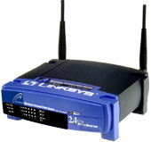
802.11i Protocol (WPA2)
Link Layer
Supplicant
UnAuth/UnAssoc
802.1X Blocked
No Key
Supplicant
Auth/Assoc
802.1X Blocked
No Key
Supplicant
Auth/Assoc
802.1X Blocked
MSK
Supplicant
Auth/Assoc
802.1X Blocked
PMK
Supplicant
Auth/Assoc
802.1X UnBlocked
PTK/GTK
Supplicant
Auth/Assoc
802.1X UnBlocked
New GTK
Authenticator UnAuth/UnAssoc
802.1X Blocked
No Key
Authenticator Auth/Assoc
802.1X Blocked
No Key
Authenticator Auth/Assoc
802.1X Blocked
No Key
Authenticator Auth/Assoc
802.1X Blocked
PMK
Authenticator Auth/Assoc
802.1X UnBlocked
PTK/GTK
Authenticator Auth/Assoc
802.1X UnBlocked
New GTK
Authentica-tion Server (RADIUS)
No Key
Authentica-tion Server (RADIUS)
No Key
Authentica-tion Server (RADIUS)
MSK
Authentica-tion Server (RADIUS)
No Key
Authentica-tion Server (RADIUS)
No Key
Supplicant
Auth/Assoc
802.1X UnBlocked
PTK/GTK
Authenticator Auth/Assoc
802.1X UnBlocked
PTK/GTK
Authentica-tion Server (RADIUS)
No Key
Authentica-tion Server (RADIUS)
No Key
802.11 Association
EAP/802.1X/RADIUS Authentication
MSK
4-Way Handshake
Group Key Handshake
Data Communication
Notes:
RSNA involves three entities: the Supplicant, the Authenticator, and the Authentication Server. In an general infrastructure network, the supplicant is implemented in the mobile devices like a PDA, a cellphone or a laptop; the authenticator is implemented in the Access Point; the authentication server could be implemented either in the Access Point with the authenticator, or separately in a backend server, like a RADIUS server. When it is implemented in a separate server, the links between the authenticator and the authentication server are assumed to be physically secure.
In order to adopt 802.1X authentication in wireless networks, we consider the association between the supplicant and the authenticator as a logical 802.1X port. At the beginning, the supplicant and the authenticator are unauthenticated and unassociated, 802.1X ports are blocked, and there are no shared secrets between them.
In the first stage, the supplicant and the authenticator set up an 802.11 association. After this stage, the supplicant and the authenticator go to the authenticated and associated state. Here “authenticated” only means that 802.11 open system authentication is successful, this is not considered to be a real authentication. Now there is a radio connection between the supplicant and the authenticator, but they cannot transmit data packets to each other because the logical 802.1X port is still blocked, only protocol packets are accepted.
In the second stage, the authenticator will act as a relay, the supplicant and the authentication server run some mutual authentication protocol and generate some common secret, called MSK (Master Session Key). Then the server moves the MSK to the authenticator, and the supplicant and authenticator will derive the same PMK (Pair-wise Master Key) from the MSK locally. Here “move” means the server will delete the key itself after sending to the authenticator, because the server is assumed not to disclose and possess the key afterwards. This stage could be absent when a Pre-Shared Key or a cached PMK is used.
In the third stage, the authenticator initialize a 4-way handshake to confirm the PMK existence and derive a fresh PTK for the following data sessions. Upon this point, the 802.1X ports are unblocked to accept data packets.
As the fourth stage, the supplicant and the authenticator might also perform a group key handshake to distribute a GTK in case of multicast applications, however, this is not necessary since the GTK (Group Transient Key) could also be transmitted in the 4-way handshake.
With the shared PTK and GTK, the supplicant and authenticator could derive the encryption key and MAC key, thus perform secure data communications.
We will focus on the 4-way handshake because it is an essential part in all operation modes.

Slide 3
TCP/IP connectivity

Slide 4
Basic Layer 2-3 Security Problems
Transport layer security
Network packets pass by untrusted hosts
Eavesdropping, packet sniffing
Especially easy when attacker controls a machine close to victim
TCP state can be easy to guess
Enables spoofing and session hijacking

Slide 5
Virtual Private Network (VPN)
Three different modes of use:
Remote access client connections
LAN-to-LAN internetworking
Controlled access within an intranet
Several different protocols
PPTP – Point-to-point tunneling protocol
L2TP – Layer-2 tunneling protocol
IPsec (Layer-3: network layer)
Data layer

Slide 6
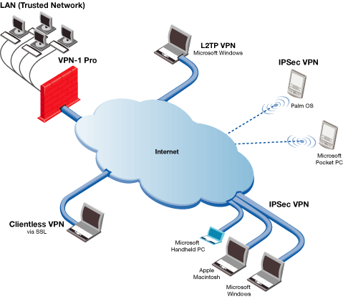
Credit: Checkpoint

Slide 7
IPSEC
Security extensions for IPv4 and IPv6
IP Authentication Header (AH)
Authentication and integrity of payload and header
IP Encapsulating Security Protocol (ESP)
Confidentiality of payload
ESP with optional ICV (integrity check value)
Confidentiality, authentication and integrity of payload

Slide 8
Recall packet formats and layers
TCP Header
Application
Application message - data
message
Transport (TCP, UDP)
segment
TCP
data
TCP
data
TCP
data
Network (IP)
packet
IP
TCP
data
Link Layer
frame
ETH
IP
TCP
data
ETF
IP Header
Link (Ethernet)
Header
Link (Ethernet)
Trailer

Slide 9
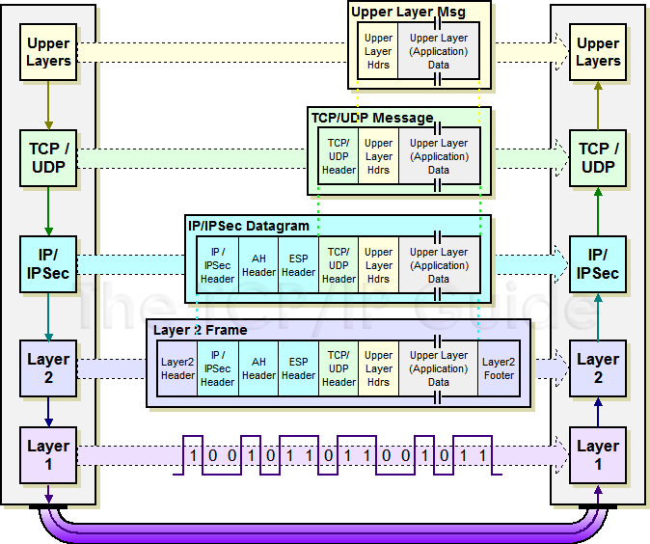
IPSec Transport Mode: IPSEC instead of IP header
http://www.tcpipguide.com/free/t_IPSecModesTransportandTunnel.htm

Slide 10
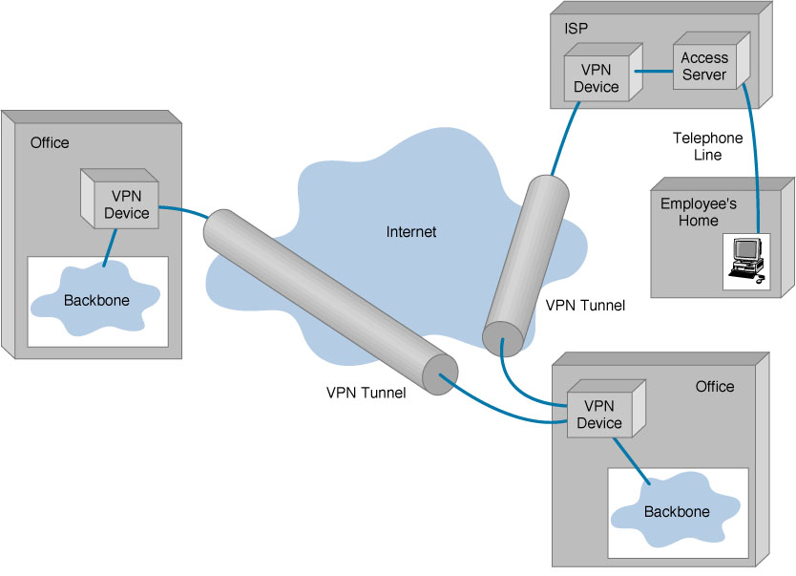
IPSEC Tunnel Mode

Slide 11
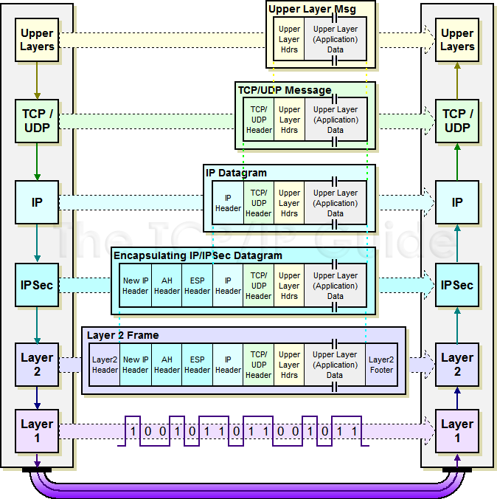
IPSec Tunnel Mode: IPSEC header + IP header

Slide 12
IKE subprotocol from IPSEC
Key management
m1
A, (gª mod p)
B, (g^{b} mod p)
, signB(m1,m2)
signA(m1,m2)
A
B
m2
Result: A and B share secret g^{ab} mod p

